Slide 1

CAREER GUIDANCE
Notes:
Career Guidance

Slide 2
TEAM MEMBERS
P.JEEVANA JYOTHI (18L61A0526)
P.RATAN TEJA (18L61A0503)
T.SRINIVAS (18L61A0542)
P.VARDAN (18L61A0501)
G.MANOJ KUMAR (18L61A0547)
Career Guidance
Notes:
Career Guidance

Slide 3
CONTENTS
Abstract.
Introduction.
Existing System.
Drawbacks.
Proposed System.
Advantages.
Working Module.
Software Requirements.
Hardware Requirements
Dataflow Diagram.
Output Screens.
Future Enhancements.
Conclusion.
Career Guidance
Notes:
Career Guidance

Slide 4

ABSTRACT
This abstract provides an overview of Career Guidance a web application which builds a career by providing tips and advice for university or college students. The project is designed to create an Online based guidance tool that would help students explore and make decisions about their career paths.
Career Guidance
Notes:
Career Guidance

Slide 5
INTRODUCTION
Career Guidance System using Machine Learning is developed for Engineering Graduates who have completed their final year (Computer Science), who are confused regarding which field/path to choose for their career.
As there are already many options available to choose Careers , still taking the correct decision is a challenge.
So we have considered all the aspects which are important to choose a Career, aspects considered in our project are selecting the categories based on their interests and submit that page
Career Guidance
Notes:
Career Guidance

Slide 6
To overcome this, We are developing a website by using machine learning Technology.
Career Guidance
Notes:
Career Guidance

Slide 7
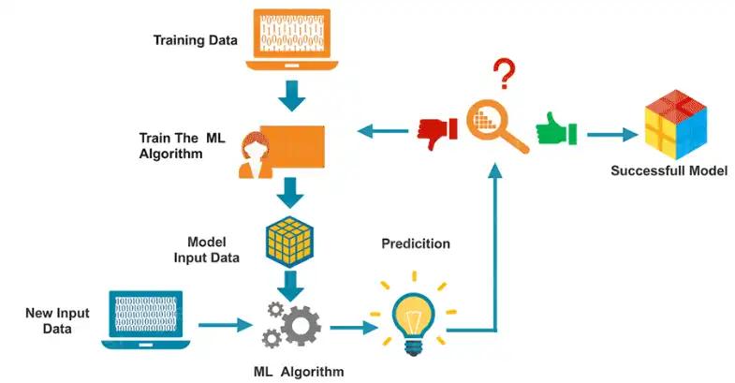
WORKING OF MACHINE LEARNING
Career Guidance
Notes:
Career Guidance

Slide 8

EXISTING SYSTEM
There is no unified Online Career Guidance System for career guidance. Students generally have to go through hundreds of websites sites to choose correct career path.
In the absence of adult guidance, they often find it difficult to find relevant information about the career they want. Generally students make poorly researched decisions which they then have to struggle with.
Career Guidance
Notes:
Career Guidance

Slide 9




EXISTING SYSTEM ARCHITECTURE
Selects Type of career path
Website
Performs guidance
Exits from the website
Career Guidance
Notes:
Career Guidance

Slide 10

DRAWBACKS
Less career options
User needs to visit each and every website individually
User may not be aware of different career paths that are currently available .
Career Guidance
Notes:
Career Guidance

Slide 11
PROPOSED SYSTEM
The Career Guidance System begins with choosing a career. Students will be able to view various career choices like courses available for them , Knowledge Network (Trending technologies are listed along with some information ) , there is a career prediction module that provides certain categories to rate themselves to get right career path
Career Guidance
Notes:
Career Guidance

Slide 12
PROPOSED SYSTEM
A Counsellor module also involved where students can ask their doubts and get rectified through one to one chat .
There are some set of categories provided in student dashboard module (my career) , for every category there will be a counsellor to clear the students doubts and guide them . All this information will help future college students to make a well informed choice.
Career Guidance
Notes:
Career Guidance

Slide 13
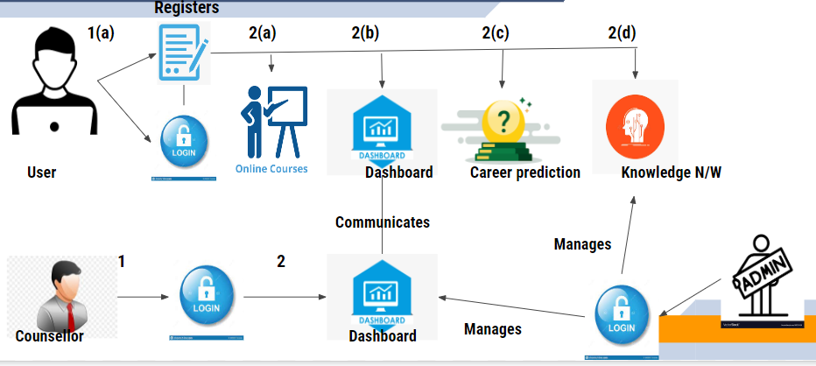
PROPOSED SYSTEM ARCHITECTURE
Notes:
Career Guidance

Slide 14

ADVANTAGES
Student and counsellor can maintain 1:1 communication
Many career options are provided with in single platform.
Gives accurate information.
Notes:
Career Guidance

Slide 15
MODULES
Student.(Person who wants to know his career path)
Counsellor.(Person who interacts with student to clear his/her doubts)
Admin.(Person who manages both student and counsellor accounts )
Career Guidance
Notes:
Career Guidance

Slide 16




SOFTWARE REQUIREMENTS
Career Guidance
Notes:
Career Guidance

Slide 17


HARDWARE REQUIREMENTS
Mobile Laptop
Career Guidance
Notes:
Career Guidance

Slide 18
DATAFLOW DIAGRAM
Career Guidance
Notes:
Career Guidance

Slide 19
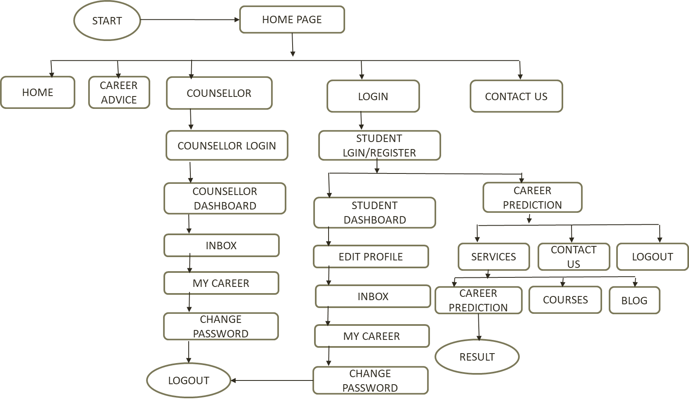
DATA FLOW DIAGRAM
Admin
Dashboard
Notes:
Career Guidance

Slide 20
OUTPUT SCREENS
Notes:
Career Guidance

Slide 21
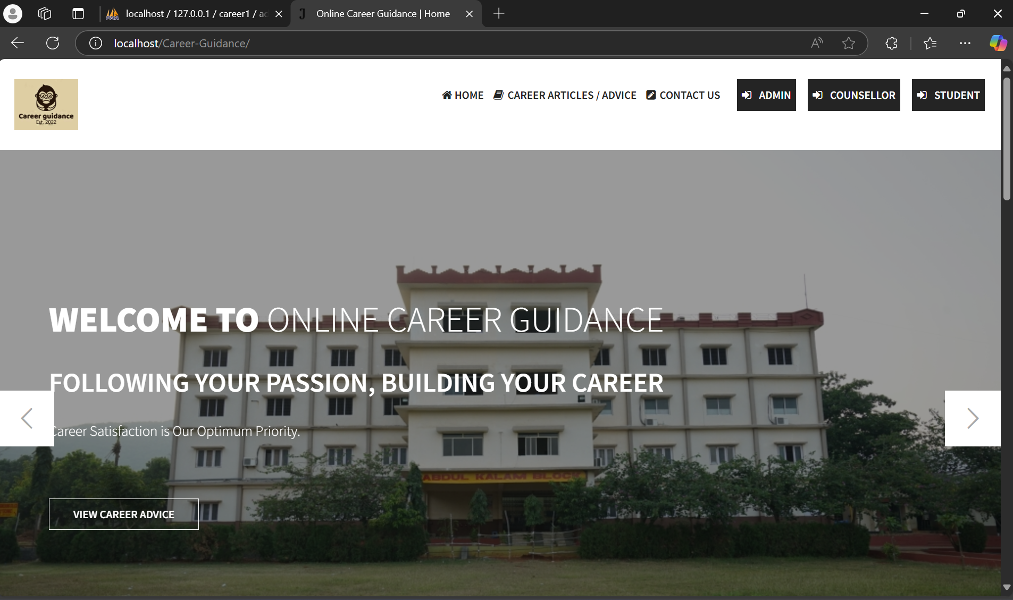
Home Page
Notes:
Career Guidance

Slide 22
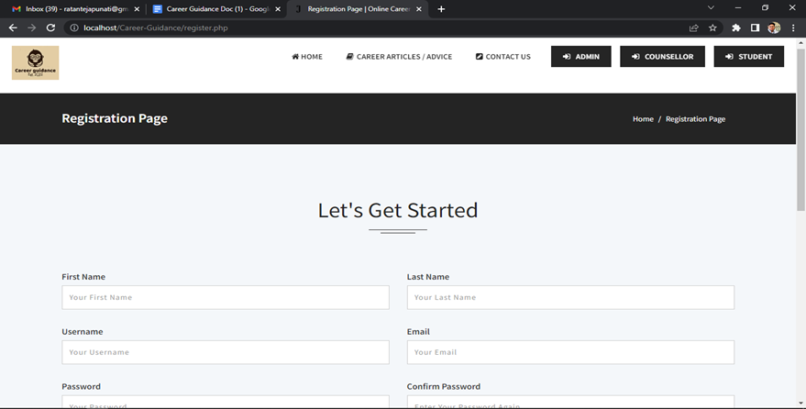
Registration Page
Notes:
Career Guidance

Slide 23
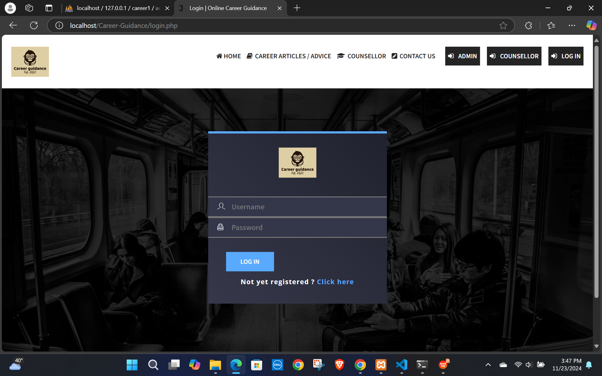
Login page
Career Guidance
Notes:
Career Guidance

Slide 24
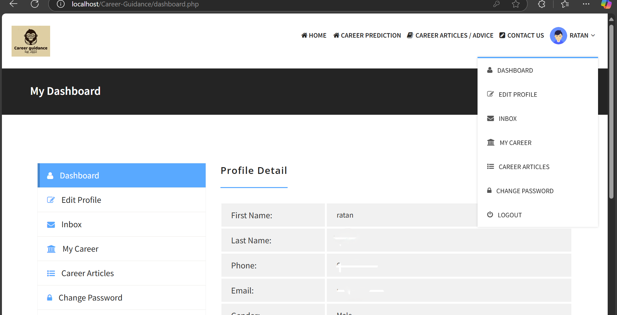
Student Dashboard
Notes:
Career Guidance

Slide 25
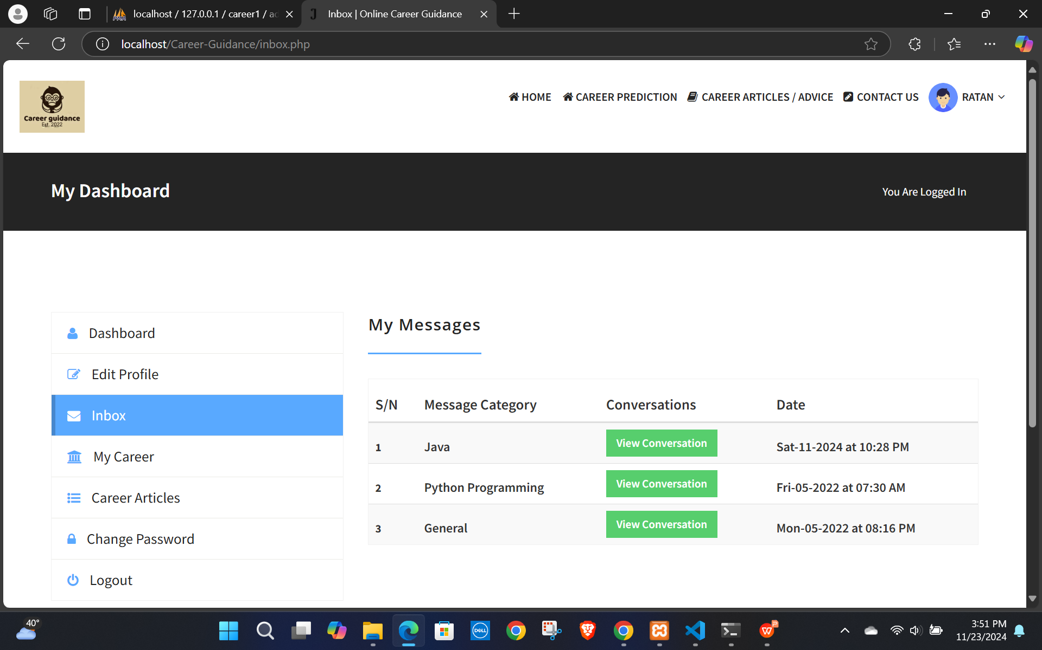
Student Inbox
Notes:
Career Guidance

Slide 26
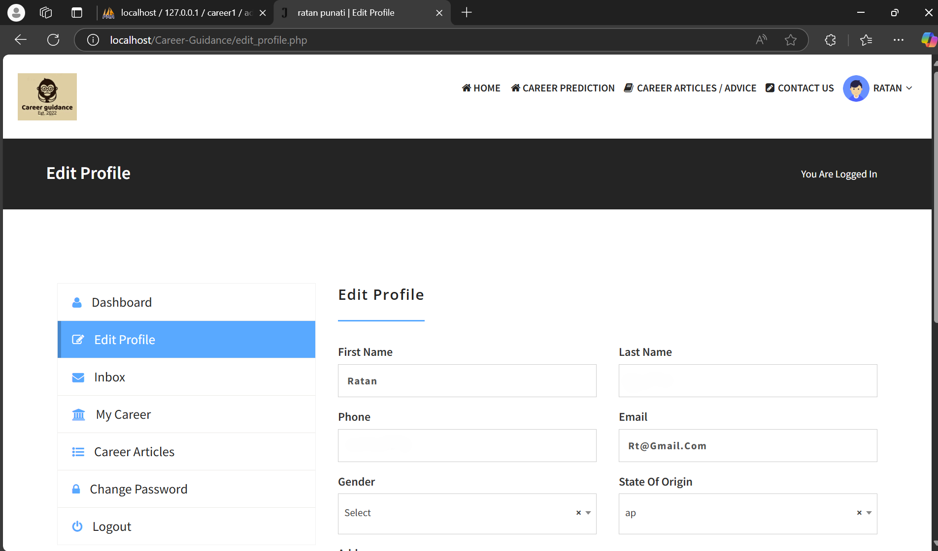
Student profile
Notes:
Career Guidance

Slide 27
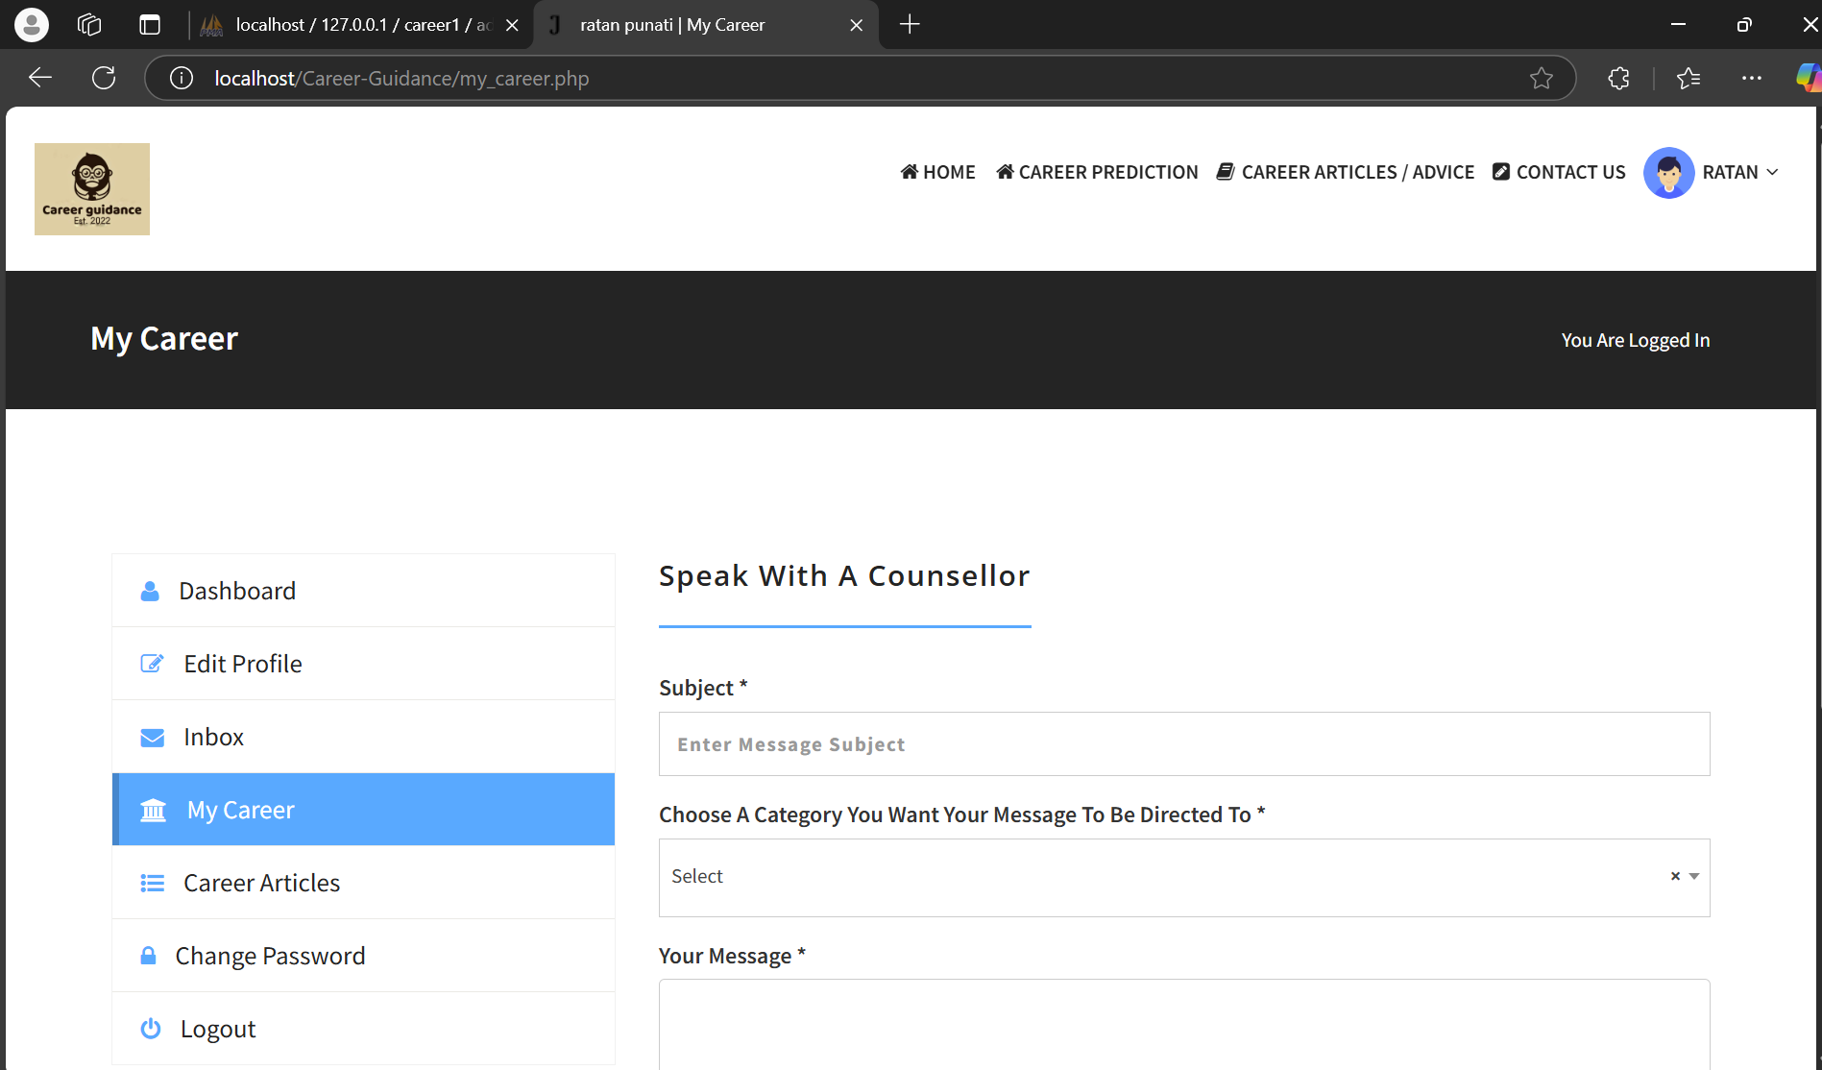
My Career
Notes:
Career Guidance

Slide 28
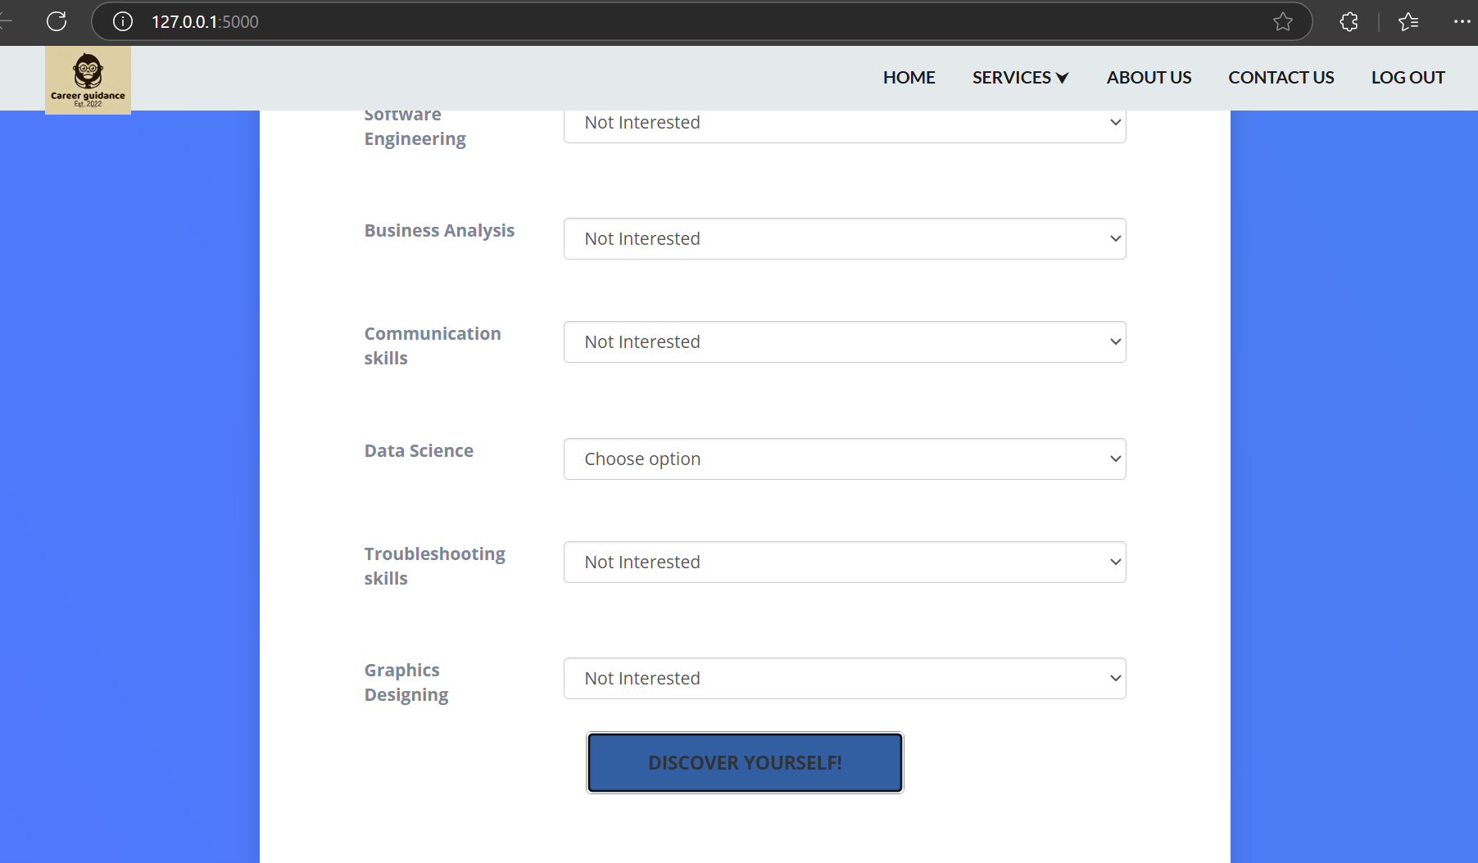
Career Prediction
Notes:
Career Guidance

Slide 29
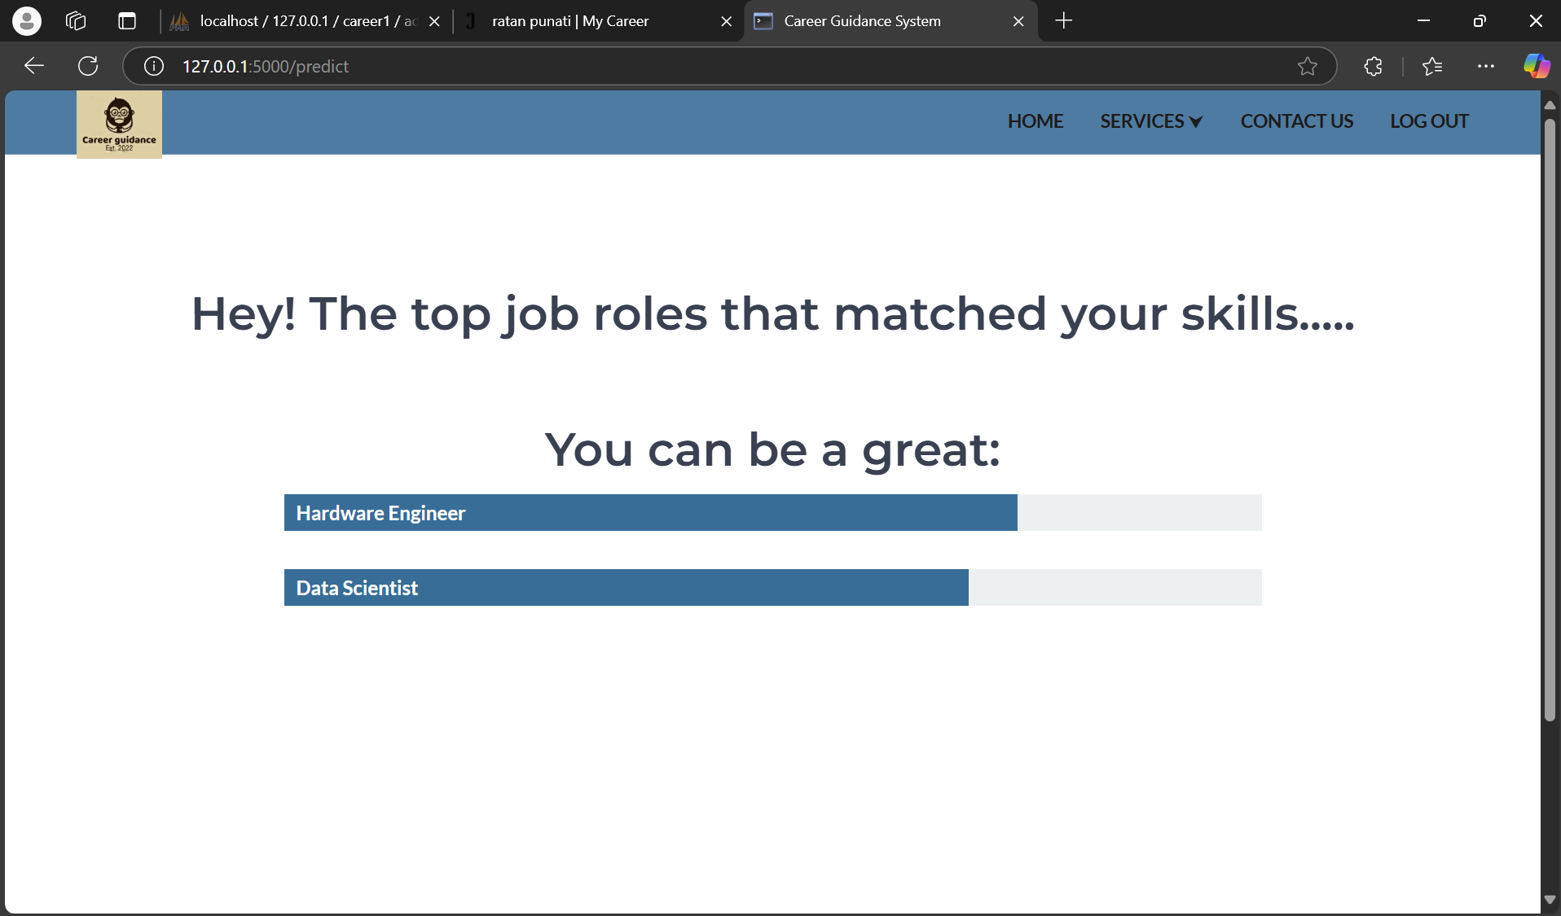
Career Guidance
Notes:
Career Guidance

Slide 30
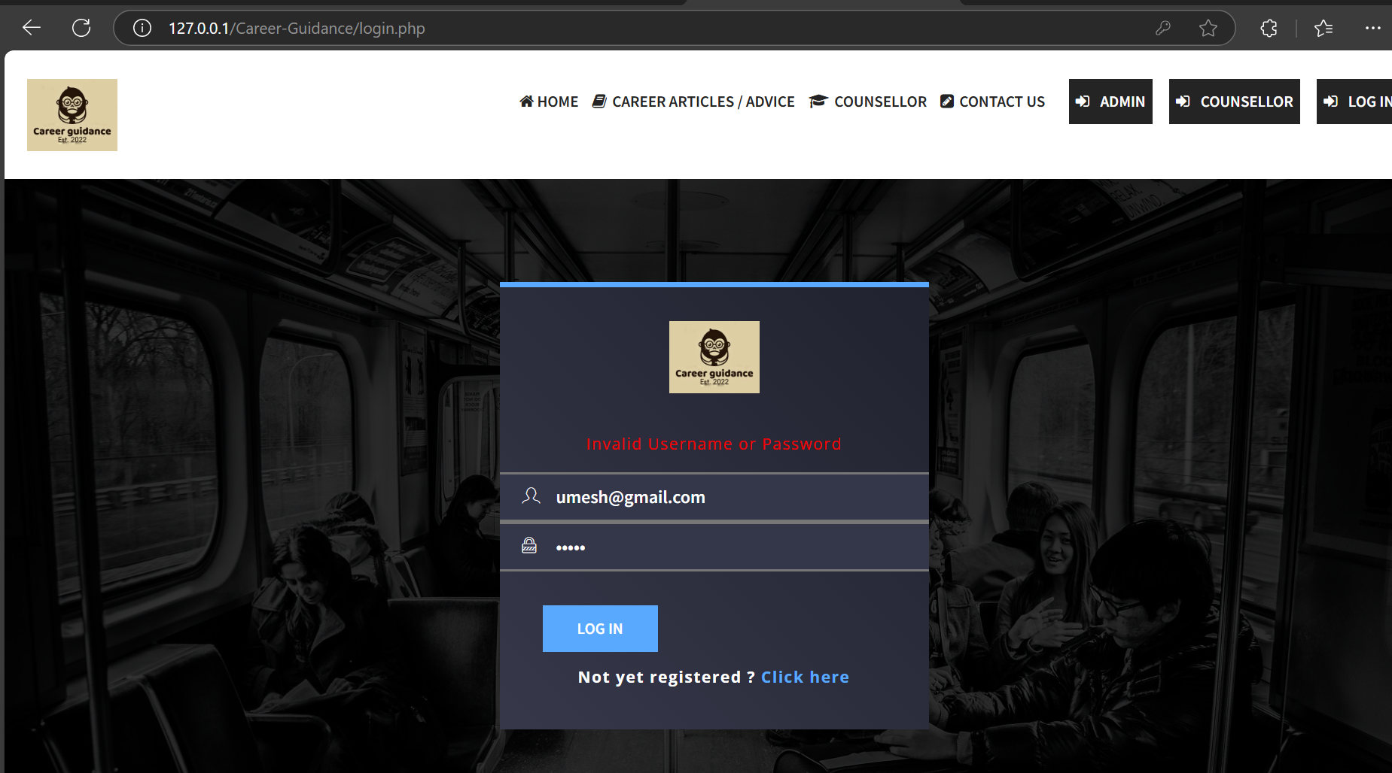
Notes:
Career Guidance

Slide 31
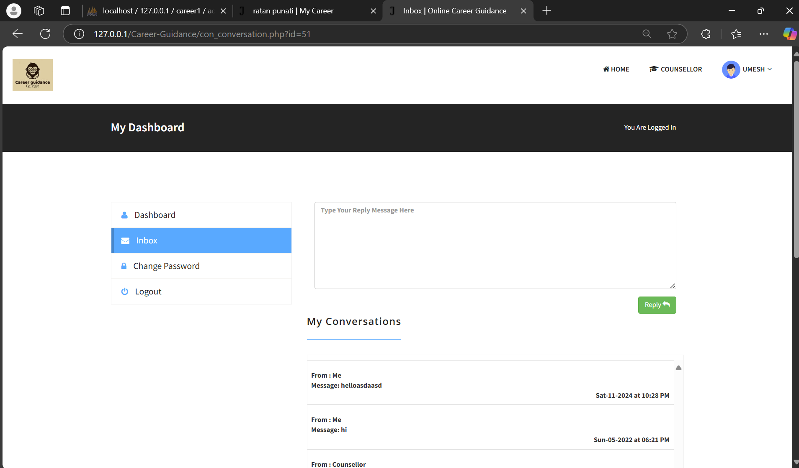
Counsellor Dashboard
Career Guidance
Notes:
Career Guidance

Slide 32
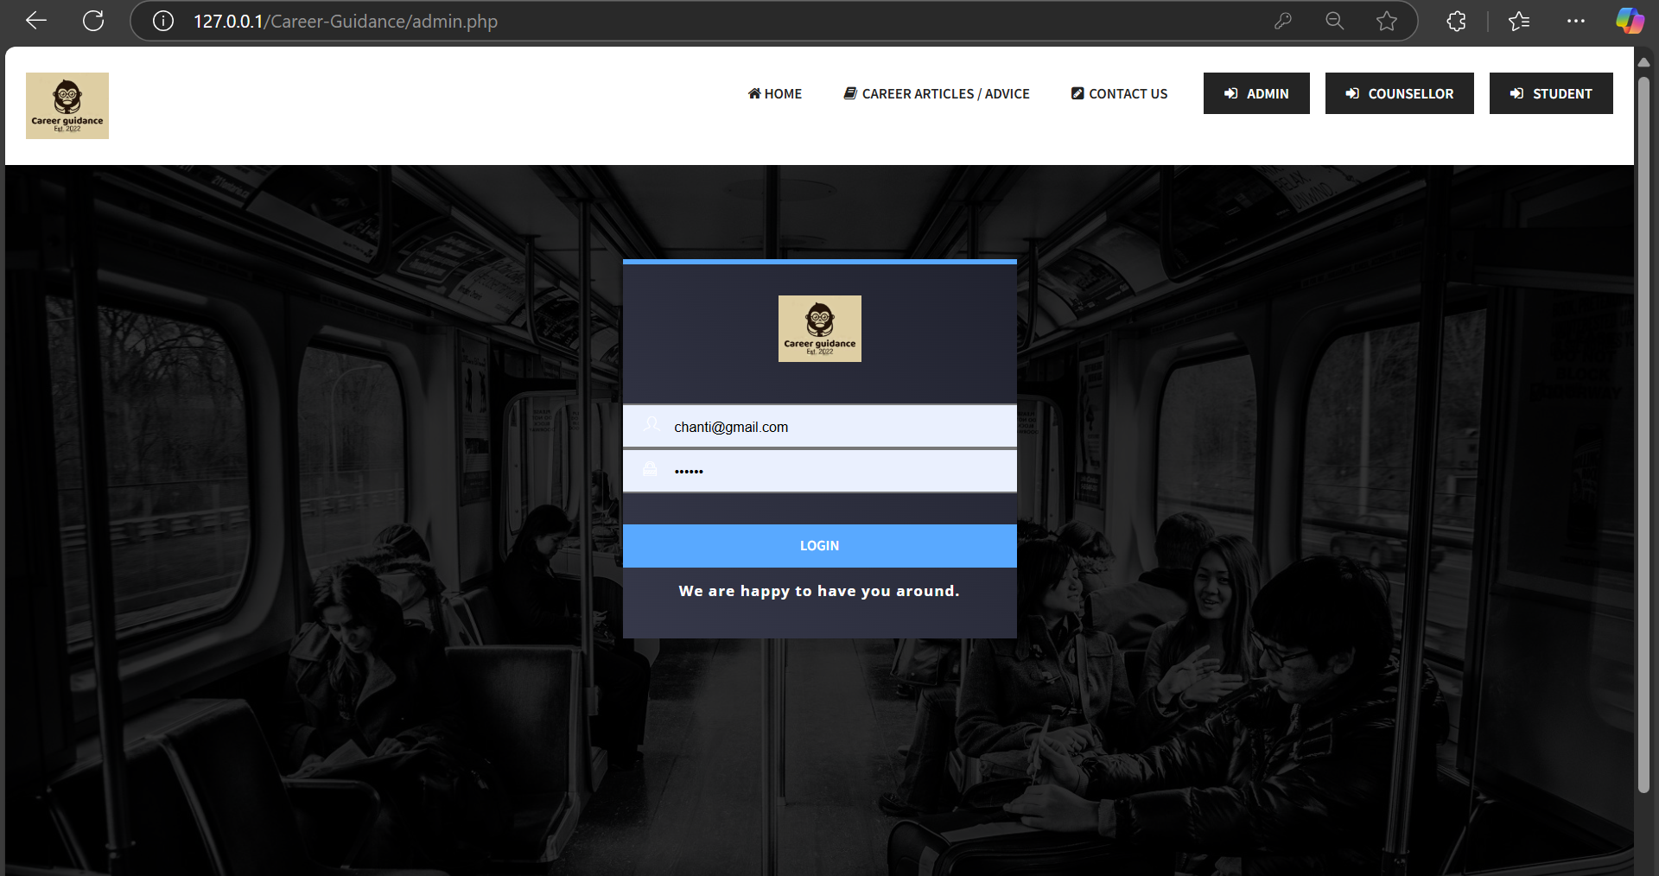
Admin Login
Career Guidance
Notes:
Career Guidance

Slide 33
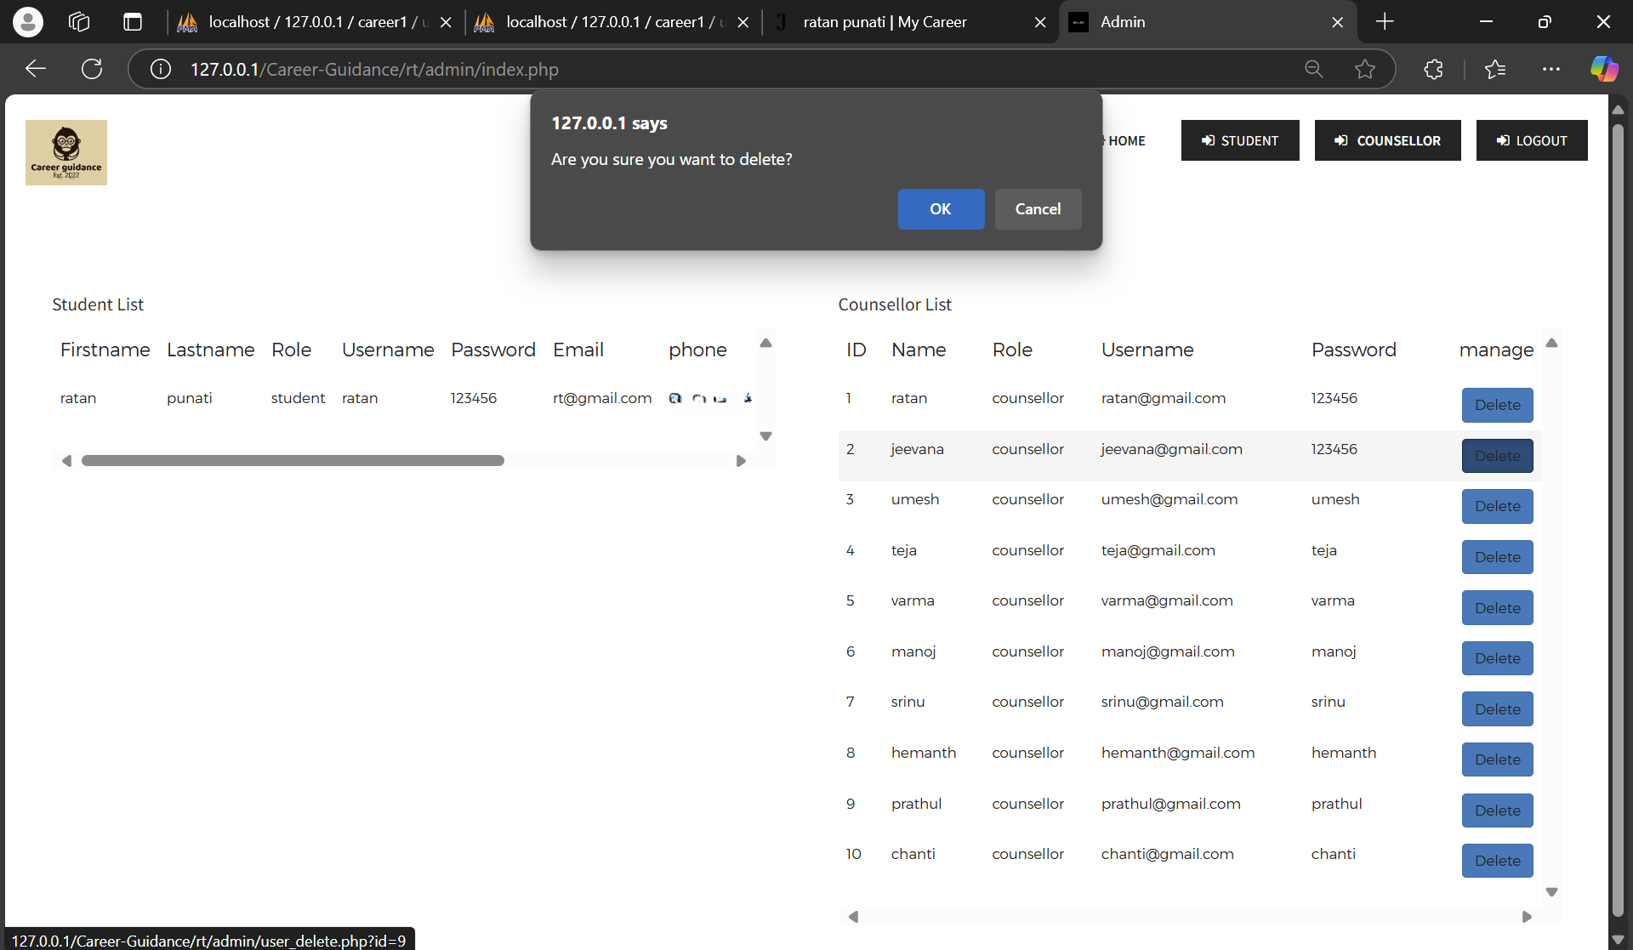
Admin page
Career Guidance
Notes:
Career Guidance

Slide 34
FUTURE ENHANCEMENT
Career Guidance in the Present and Future Taking a page from India's successful educational system.Since we only developed our system for one specific branch (IT), we can expand it by including other branches as well.We can maintain more than one counsellor for a single category .
When all the counselors are busy an alert message will be sent to the student.
.
Career Guidance
Notes:
Career Guidance

Slide 35
CONCLUSION
The paper proposes a career steering gadget which uses Machine learning for Prediction. it is handiest and efficient web application, with a view to be used by any Engineering Student of CS/IT(presently in final year or completed graduation) to assess their talent, abilities and which particular profession direction to pick out from numerous Career paths available.
Career Guidance
Notes:
Career Guidance

Slide 36

THANK YOU
Any questions?
Notes:
Career Guidance

